Slide 1
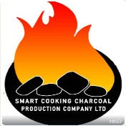
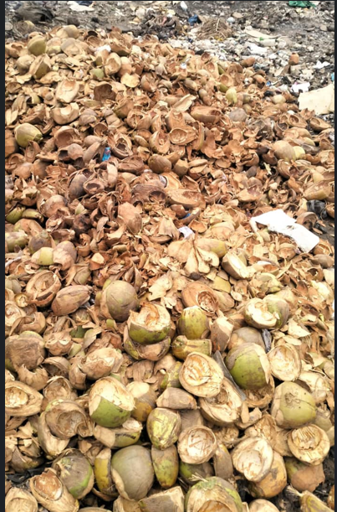
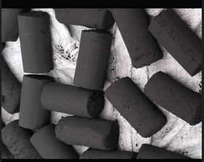
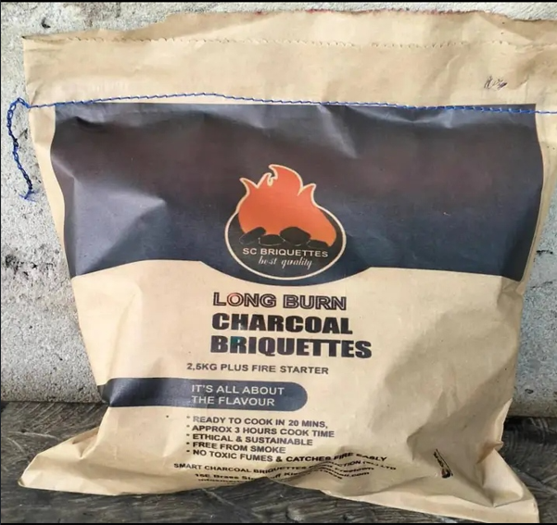
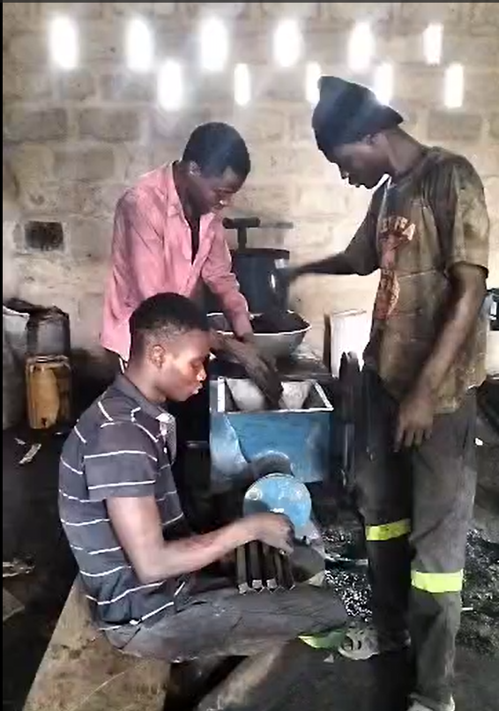
Smart Charcoal Briquette Production (SL) Ltd.
Proposal full title | Eco-Friendly Charcoal Briquette-Clean Cooking Sustainable Energy
project coordinator Telephone No. Email Address | Samsudeen O. Bangura +23278181994 Samsudeenbangura@gmail.com
Countries involved in the project | Sierra Leone West Africa
Website | In progress and proposed address WWW. Smartcharcoalbriquette.com
Start date (month/year) | January 2026 | Total Project Costs in USD: | $25,000
Implement Project Period | 2 Months | Requested funds in USD | $25,000
Pilot Test

Slide 2
Smart Charcoal Briquette Production (SL) Ltd.
Overview/Background: | Smart Charcoal Briquette production is producing environmental friendly charcoal briquette, using biomass waste such as coconut shell and show dust. We did not cut down any tree during the manufacturing process.
Objective | Our main aim is to produce Eco-friendly charcoal Briquette- Clean Cooking sustainable Energy in Sierra Leone. Our product is unique and ready to use in two minute, it can burn more than two hours, it ethical and sustainable, free from smoke, no toxic fumes and catches fire easily. Branding and Packaging, we have the best branding which is Cement paper bag. Our packaging will be in kilograms such as 2.5kg, 5kg, 10kg and 15kg.
Needs to be addressed: | We establish this project to protect and save our planet/ Communities, from deforestation, Woman in haling toxic fumes, Sea, Air and Land pollution, Landslide etc.
Pilot Test

Slide 3
Smart Charcoal Briquette Production (SL) Ltd.
Expected impact of outcomes and potential benefits: | By the end of this project am expecting the following impact and potential benefits to Sierra Leonean. Environmental, Social and Economic impact of briquette production: Environmental Impact and potential benefits: -Carbon Emission Reduction: One of the significant advantages of using charcoal briquettes is their lower carbon emission compared to traditional charcoal. Briquettes are made from recycled materials, such as Coconut shell, sawdust, or agricultural waste, which are compressed into uniform shapes. -Deforestation Mitigation: The production of traditional charcoal often leads to deforestation as trees are harvested for their wood. This practice contributes to habitat loss, soil erosion, and a decline in biodiversity.
Pilot Test

Slide 4
Smart Charcoal Briquette Production (SL) Ltd.
Expected impact of outcomes and potential benefits: | Social Impact and potential benefits: •Biomass briquettes are carbon-neutral, meaning they release no additional carbon dioxide into the atmosphere when burned •By reducing reliance on fossil fuels, the adoption of biomass briquettes helps mitigate greenhouse gas emissions, thus contributing to climate change mitigation efforts. •By diverting residues towards productive use, biomass briquettes play a crucial role in waste management and carbon sequestration, further enhancing their environmental credentials. Economic Impact and potential benefits:
Pilot Test

Slide 5
Smart Charcoal Briquette Production (SL) Ltd.
Expected impact of outcomes and potential benefits: | 98% of Sierra Leone population are using charcoal briquette and consumers have discovered the advantages of briquettes, and the demand for biomass briquettes has been growing. Renewable initiatives have further boosted the possibilities for briquetting, and therefore prices have increased, and suppliers have been struggling to keep up with the progressive market. Therefore, briquetting is a profitable business in most circumstances.  Furthermore, densification of biomass is an important element in trading and handling biomass, as densified fuel offers logistical advantages and becomes a commodity ensuring high energy content and homogeneous quality ocial Impact and potential benefits:
Pilot Test

Slide 6
Smart Charcoal Briquette Production (SL) Ltd.
Work planning, stakeholder involvement: | We are engaging both the internal stakeholder and External stakeholder and ensuing they participate on this project. Below are our targeted stakeholders: 1. Project Manager: Responsible for planning and overseeing the project from start to finish. 2. Team Members: Individuals directly working on the project tasks. 3. Resource Managers: Responsible for securing resources necessary for project execution. 4. Executives & Senior Management: Provide strategic direction and make high-level decisions. 5. Sponsors: Support and fund the project and the team working on it. 6. Vendors: Provide goods or services needed for the project. 7. End Users: The individuals who will use the product or service once the project is complete. 8. Government: Government agencies that collect taxes and are concerned with the project’s broader social and economic impact
Pilot Test

Slide 7
Smart Charcoal Briquette Production (SL) Ltd.
Indicate the Multi Annual Roadmap(s) to which my proposal relates: | 1. Clean Cooking sustainable Energy 2. West Management 3. Restoring Forest 4. Clean Air, Sea and Land Pollution 5. Carbon Emission Reduction
Expected impacts at African and/or international | Provide Employment Facility and Income in Rural Areas: Charcoal briquette production and trade contributes to the national economy by providing rural incomes, tax revenue and employment. Recycle the Waste and Reduce Pollution Improved Air Quality Sustainable Fuel Choice: Opting for charcoal briquettes supports sustainable fuel choices
Pilot Test

Slide 8
Smart Charcoal Briquette Production (SL) Ltd.
BUDGET
S/N | Description | Amount (USD)
01. | Purchase of Advance Machines from China Crusher Machine, Extruder/Briquette Machine, Carbonization Machine and Dryer Machine | 13,000
02. | Shipment and Clearing from China port to Freetown port | 4,500
03. | 15KVA-20KVA Generator | 3,000
04 | Delivery Van | 3,000
05 | Transport and payment of raw material from various dumpsite to the factory | 1,500
 | Grand Total | 25,000
Pilot Test

Slide 9
Smart Charcoal Briquette Production (SL) Ltd.
THANK YOU
ANY
QUESTION?
Pilot Test

